Slide 1
25/02/2025
TE IT / SEM VI
MP1A
R 19 C Scheme
Anjuman-I-Islam’s
M.H. Saboo Siddik College of Engineering
8, Saboo Siddik Polytechnic Road, Byculla – 08
DEPARTMENT OF INFORMATION TECHNOLOGY
ITM501 Mini Project – 2 B Based Machine Learning
DIABETICS PREDICTION
SYSTEM
Under the Guidance of
Dr. Irfan Landge

Slide 2
TEAM MEMBERS NAME
SUTAR NAVED ROLL NO.:- 221455
ANSARI SAAD ROLL NO.:- 221458
MOMIN ADEEN ROLL NO.:- 221426
SHAIKH HUJAIFA ROLL NO . :-221444

Slide 3
INTRODUCTION
Diabetes is a chronic disease that occurs when the pancreas does not produce enough insulin or when the body cannot effectively use the insulin it produces. Early detection of diabetes is crucial as it helps in managing the disease and preventing severe complications. Machine learning plays a significant role in healthcare by enabling the analysis of health parameters to predict the likelihood of diseases like diabetes with high accuracy. The objective of this project is to develop a Python-based web application that predicts diabetes using health parameters such as Pregnancies, Glucose, Blood Pressure, Skin Thickness, Insulin, BMI, Diabetes Pedigree Function, and Age. This system aims to provide a reliable and automated solution for diabetes prediction, making it accessible to users through a user-friendly interface.

Slide 4
PROBLEM DEFINITION
Diabetes is a growing health concern worldwide, and its early detection is essential for effective management. However, manual diagnosis can be time-consuming and prone to errors. The challenges include the lack of early detection systems, inefficient manual analysis of health parameters, and the need for a reliable and automated prediction system. To address these issues, this project proposes a machine learning-based web application that predicts diabetes using user-provided health parameters. By automating the prediction process, the system aims to provide quick and accurate results, helping users take proactive steps toward their health.

Slide 5
PORPOSED SYSTEM
The proposed system is a web application that allows users to input health parameters such as Pregnancies, Glucose, Blood Pressure, Skin Thickness, Insulin, BMI, Diabetes Pedigree Function, and Age. The data is sent to the backend, where a pre-trained machine learning model processes it and predicts whether the user has diabetes or not. The result is then displayed to the user on the website. The system is built using Python for the backend, with Flask or Django as the web framework. The frontend is developed using HTML, CSS, and JavaScript, while the machine learning model is trained using libraries like Scikit-learn, Pandas, and NumPy. The Pima Indians Diabetes Dataset is used for training the model. The workflow involves user input, data processing by the model, and displaying the prediction result in real-time.

Slide 6
LITERATURE REVIEW
Sr. No. | Paper Name | Journal Name | Published Year | Comparative Analysis
1 | Diabetes Prediction Using Machine Learning Algorithms | IEEE Access | 2020 | Compared SVM, Random Forest, and Logistic Regression; Random Forest achieved highest accuracy.
2 | A Comparative Study of Diabetes Prediction Using Data Mining Techniques | International Journal of Advanced Computer Science and Applications | 2019 | Compared Naive Bayes, Decision Tree, and KNN; Decision Tree performed best.
3 | Early Diabetes Prediction Using Machine Learning Techniques | Journal of Medical Systems | 2021 | Used ANN and achieved 85% accuracy; highlighted the importance of feature selection.

Slide 7
H/W & S/W Requirements
Software Requirements
Operating System: Windows, Linux, or Mac.
Programming Language: Python.
Libraries and Frameworks:
Scikit-learn (for machine learning).
Pandas and NumPy (for data processing).
Flask or Django (for backend web development).
Frontend Development:
HTML, CSS, and JavaScript.
IDE/Tools:
PyCharm, Jupyter Notebook, or VS Code.
Web Browser: Chrome, Firefox, or Edge (for accessing the web application).
Hardware Requirements
Processor: Intel i3 or higher.
RAM: 4GB or higher.
Storage: 500GB HDD or 256GB SSD.
Internet Connection: Required for web deployment and access.

Slide 8
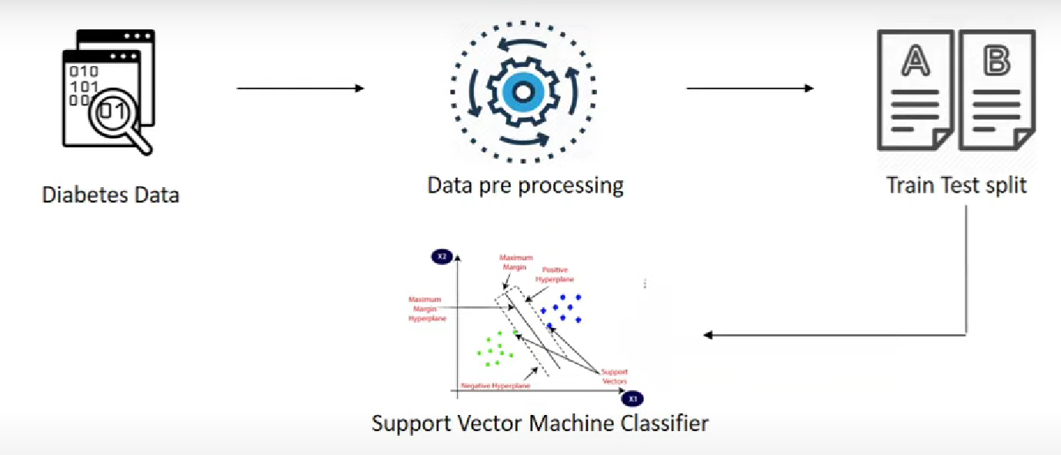
WORKFLOW

Slide 9
CONCLUSION
The Diabetics Prediction System is a Python-based web application that uses machine learning to predict diabetes based on user-provided health parameters. The system offers several advantages, including early detection of diabetes, a user-friendly interface, and high accuracy using machine learning models. In the future, the system can be enhanced by integrating it with wearable devices for real-time health monitoring, expanding the dataset for better model accuracy, and adding more health parameters for improved predictions. This project demonstrates the potential of machine learning in healthcare and its ability to provide accessible and reliable solutions for disease prediction.

Slide 10
REFERENCES
THANK YOU !
Thank you for your attention! Questions and feedback are welcome.

